Slide 1
Session 1
Working with SQL Server Database Objects
Faculty: Nguyen Ngoc Tu

Slide 2
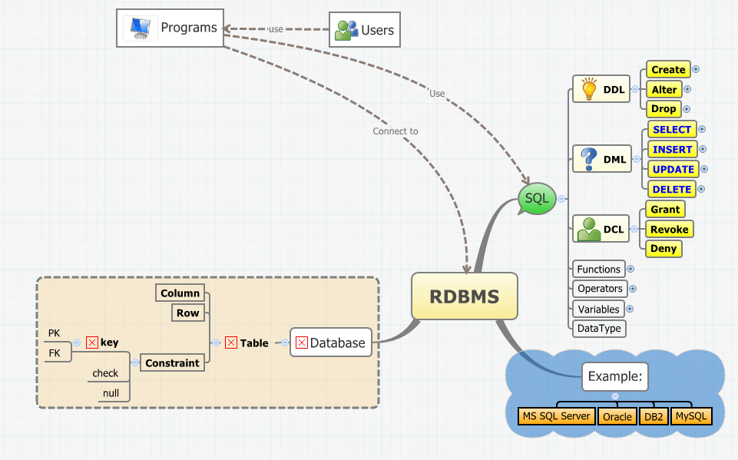
…Review

Slide 3
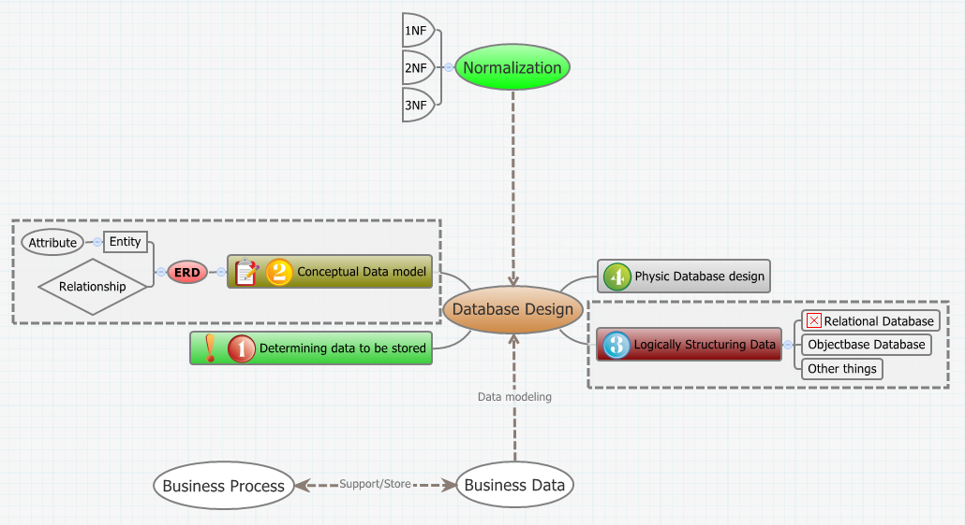
…Review

Slide 4
Topics
Introduction to Data Integrity
Data Integrity
Types of Data Integrity
Integrity Constraints
Introduction to Indexes
Introduction to Indexes
Index Architecture
Retrieving Stored Data
Finding Rows

Slide 5
I- Introduction to Data Integrity
Data Integrity
Types of Data Integrity
Integrity Constraints

Slide 6
Problem: Need for updating data
HumanResource Table
?
update
HR Department
Update?
?
Payroll Department
Data Integrity
update
?
Payroll Table

Slide 7
What is Data Integrity?
☑Correct
Data Integrity
assurance
Consistent
Consistent: if any modification or deletion is carry out on the data, the change should reflect in all the relevant place in database.
Correct: the enter value need to be valid and accurate.

Slide 8
How to maintain the Integrity of data?
Integrity of data can be maintained by specifying certain checks at all time of any operations.
insert
Checks Data Integrity
Yes
Valid operations
delete
update
No
Discard the change
create

Slide 9
Rule for data integrity
Data integrity need to be maintained for data to be useful.
There are certain rules that help maintaining the correctness and consistency of data:
Uniqueness: No 2 records in a table can have the same values in all the columns
Validity: Only valid data values can be inserted, the validity of data has to be maintained when data is modified.
Consistency: When multiple table are related through a common column, any changes to the data value in that column should be appropriately reflected in all the related tables.

Slide 10
Business rules
Business rules are the policies and standards adhered to by an organization in running its operations.
The rules ensure that the data entered in the database conforms to company standards.
For example: the business rules of a bank apply for the loan repayment based on a person’s education level, income and age.

Slide 11
Enforcing Data integrity in SQL2005
Sql2005 support four mechanisms that allow you to enforce data integrity:
Constraints
Data types
Not Null definitions
Identity properties
Default values
Rules (replace by CHECK)
Triggers

Slide 12
Game
Validity
Refer to validity and consistency of data
Business Rules
Prevent invalid data from being entered into the columns
Constraints
Ensures that the data lies within a specified type and rang constraint
Data integrity
Refer to policies and standards adhered t0 by an organization in running its operations

Slide 13
Types of data integrity
Data Integrity
Entity Integrity
Domain Integrity
Referential Integrity
User-defined Integrity
3
4
1
2

Slide 14
1- Entity Integrity
Entity integrity concerns the concept of a primary key.
In SQL2005:
PRIMARY KEY constraint
UNIQUE constraint
IDENTITY property
Indexes

Slide 15
2- Domain Integrity
Domain integrity specifies that all columns in relational database must be declared upon a defined domain.
In SQL2005:
Data types
NOT NULL
DEFAULT
CHECK
FOREIGN KEY
Rules

Slide 16
3- Referential Integrity
Referential integrity concerns the concept of a foreign key.
The rules for referential integrity:
Check before insert
Modify corresponding records
Delete corresponding records

Slide 17
4- User-defined Integrity
User-defined Integrity refers to the rules defined by a user.
For example:
Student’s AccountNo must be in format A0001, A0002, etc.

Slide 18
Game

Slide 19
II- Introduction to Indexes
Introduction to Indexes
Index Architecture
Retrieving Stored Data
Finding Rows

Slide 20
Introduction to Indexes
What is Indexes?
Why we need the indexes?
The scenarios where indexes are essential?

Slide 21
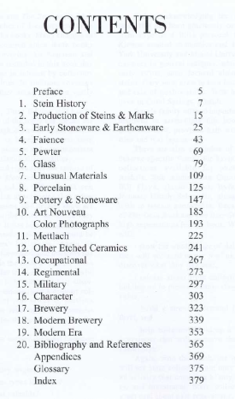

Purpose of indexes
Indexes
Indexes allow you to find specific data
without scanning through the entire table

Slide 22
Guidelines about Indexes
Indexes increase the speed of queries that join tables or perform sorting operations.
Indexes implement the uniqueness of rows if defined when you create an index.
Indexes are created and maintained in ascending or descending order.
Indexes are useful when data needs to be accessed group-wise.
Indexes should not be created if they are not used frequently since, maintaining them requires time and resources.
Indexes should not be created on columns having duplicate data.

Slide 23
Data Storage
User view
Relational Database Engine
Physical view
.mdf
Relational engine
OLE DB
Storage engine
.ndf
.ldf

Slide 24
Data Storage…
Data file
Data Page 0
Data Page 1
Data Page 2
Data Page 3
Header Page
Header Page
Header Page
Header Page
Data row 1
Data row 1
Data row 1
Data row 1
Data row 2
Data row 2
Data row 2
Data row 2
Header Page contain:
Page number
Page type
Amount of free space on the page
Allocation unit ID of the object which the page is allocated
Data Page 0
96 byte
Header Page
Data row 1
Data row 2
8Kb

Slide 25
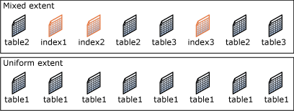
Data Storage…
Extents are the basic unit in which space is managed
Size of extends are 64kb
Two type of extent:
Mixed extent
Uniform extent
Data Page 0
Data Page 1
Data Page 2
Data Page 3
Extent
Data Page 4
Data Page 5
Data Page 6
Data Page 7

Slide 26
Index Architecture
In SQL Server 2005, all indexes are structured in the form of B-Trees.
Leaf Nodes

Slide 27
Index B-tree Structure
Root Node: contains an index page with pointers pointing to index pages at the first intermediate level.
Intermediate Nodes: contains an index pages with pointers pointing either to index or data pages at the leaf level.
Leaf Nodes: contains either data pages or index pages that point to data pages.

Slide 28
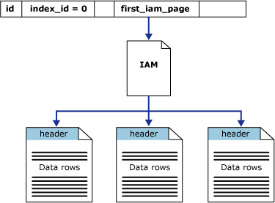
Heap Structures
In a heap structure, the data pages and records are not arranged in sorted order. The only connection between the data pages is the information recorded in the Index Allocation Map (IAM) pages.
IAM pages are used to scan through a heap structure. IAM pages map extents that are used by an allocation unit in a part of a database file.
You can read a heap by scanning the IAM pages.

Slide 29
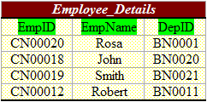
Clustered Indexes
A clustered index causes records to be physically stored in a sorted or sequential order. You can create only one clustered index in a table.
Uniqueness of a value in a clustered index is maintained explicitly using the UNIQUE keyword or implicitly using an internal unique identifier.
A clustered index is organized in the form of a B-tree. The actual data rows in the data pages present at the leaf level of the index.
Clustered Index created

Slide 30
Guidelines
A clustered index is automatically created on a table when a primary key is defined on the table.
A clustered index should ideally be defined on:
Key columns that are searched on extensively.
Columns used in queries that return large result sets.
Columns having unique data.
Columns used in table joins.

Slide 31
XML Indexes
XML indexes can be created on a table only if there is a clustered index based on the primary key of the table. This primary key cannot exceed 15 columns.
There are two types of XML indexes:.
Primary XML Indexes: special indexes that shreds the XML data to store information.
Secondary XML Indexes: help with specific XML queries.
Searching for values anywhere in the XML document.
Retrieving particular object properties from within an XML document.

Slide 32
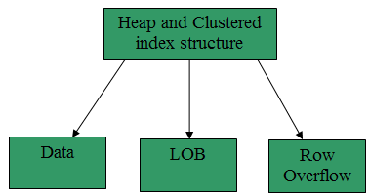
Allocation Units
A heap or a clustered index structure contains data pages in one or more allocation units. An allocation unit is a collection of pages and is used to manage data based on their page type.
The types of allocation units that are used to manage data in tables and indexes are: IN_ROW_DATA, LOB_DATA, ROW_OVERFLOW_DATA.

Slide 33
Finding Rows without Indexes
SQL Server uses catalog views to find rows when an index is not created on a table. It uses the sys.indexes view to find the IAM page.
When the sys.indexes view is used, the query optimizer checks all rows in a table and extracts only those rows that are referenced in the query. This scan generates many I/O operations and utilizes many resources.

Slide 34
Finding Rows with Nonclustered Index
The pointers in the leaf level of the index point to the storage location of the data in the underlying table.
The nonclustered index is used to search for exact-match queries. This is because the index contains entries describing the exact location of the data in the table.
For finding rows with nonclustered indexes, a SELECT statement is used with the nonclustered index column specified in the WHERE clause.

Slide 35
Summary 1
Data Integrity
Data Integrity ensures accurate and up-to-date information at any point in time.
In SQL Server 2005, data integrity is enforced using Constraints, Default Values, Rules and Triggers.
Types of Data Integrity
To maintain accuracy and consistency of data in a relational database.
Four types of integrity checks: Entity Integrity, Domain Integrity, Referential Integrity, User-defined Integrity.
Integrity Constraints
To ensure validity and consistency of data in a database.
SQL Server 2005 supports UNIQUE, CHECK, PRIMARY and FOREIGN KEY constraints on columns in a table.

Slide 36
Summary 2
Index is used for faster retrieval of data. When an index is created on a table, the index creates an order for the data rows or records in the table.
All indexes are structured in the form of B-Trees.
Indexes types
Clustered indexes
Non-clustered indexes
XML indexes

